Slide 1
Building Broad and Meaningful Engagement

Slide 2
Guiding Questions
What makes Pathways work so important & so difficult?
What are the most common barriers to effective implementation, and what approaches to engagement (skills, habits and practices) can help overcome these challenges?
What have we learned about the traits and practices of healthy team members and enlightened leaders?

Slide 3
What Makes Pathways Work So Hard? It’s about leadership, not management
Change management is a set of basic tools or structures intended organize & coordinate implementation of a discrete innovation
Change leadership concerns the driving forces, vision & processes, culture-building that fuel large-scale transformation
Source: Kotter, J. 2011

Slide 4
Moving Beyond “Buy-In”
Lack of resistance is not the same as acceptance, and even acceptance isn’t enough for enduring change
Faculty and “frontline staff” co-ownership is the key to a healthy culture for innovation
Passive noncompliance can present greater risks than active resistance

Slide 5
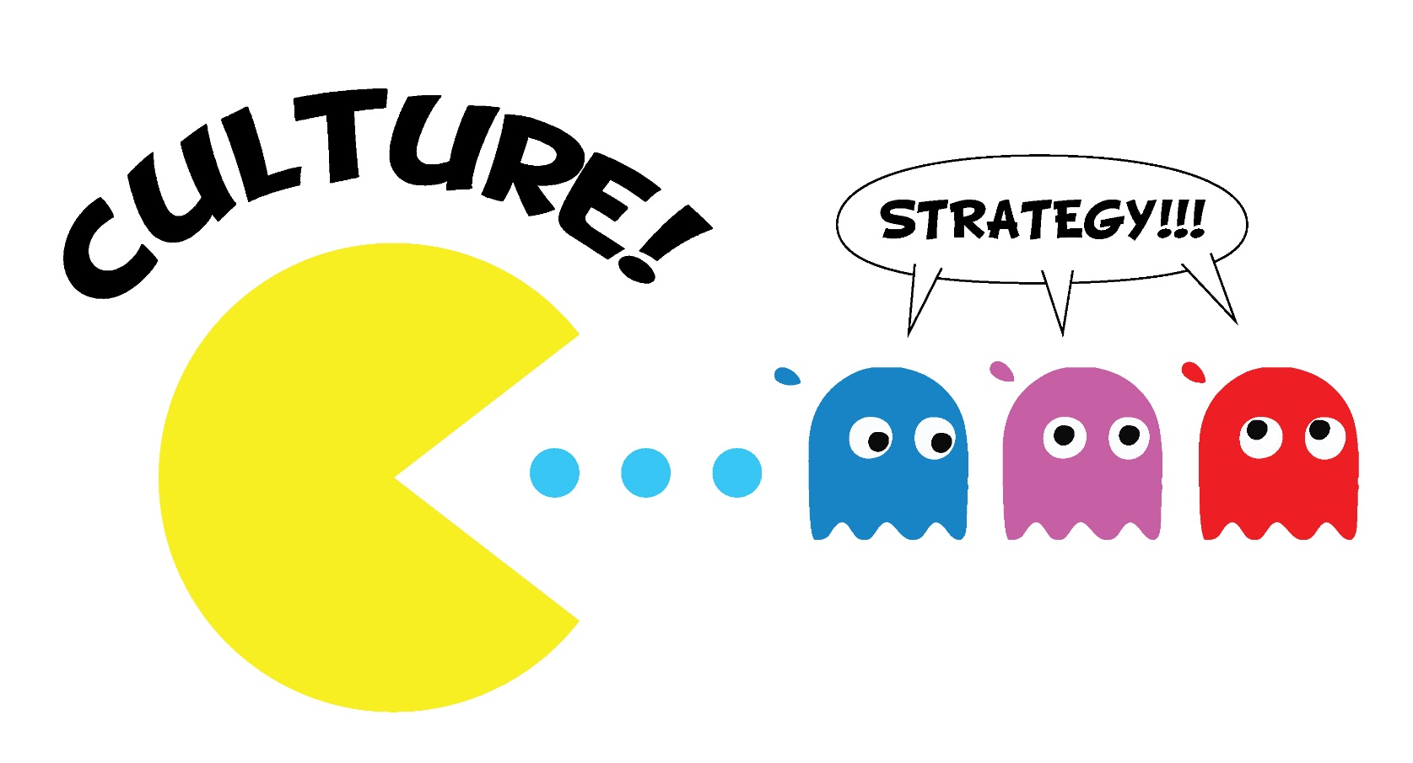
So just change the culture! Right?!

Slide 6
Focus on Climate to Influence Culture
Culture
Values, beliefs, myths, traditions, and norms that shape experience and behavior
Difficult to quantify and overwhelming to consider
Still a go-to concept in change management for many
Climate
Perceptions, expectations, and conditions shape the way people understand their work and each other
More easily assessed and influenced
A focus on climate provides a foothold and is the path to culture building

Slide 7
Examples of What We’ve Seen
Barrier
Strategy
Misaligned Leadership
Assess leadership messaging and align internally first
Lack of Authenticity
Practice the three tenets of meaningful engagement
Initiative Fatigue
Connect the dots between change initiatives
Resistance to Mandates
Create opportunities for collaborative design
Fear of Change
Understand sources of resistance; find or create new win-wins
Ineffective Communication
Make communication continuous, skillful and respectful
Incentive Gaps
Consider disciplinary expectations relative to institutional incentives

Slide 8
Getting Real About the Work
No easy answers and no shortcuts
Not about eliminating resistance but creating spaces for success
Accept that it is not one-off work – it’s ongoing
Plan for engagement as carefully as you plan for technical work

